Slide 1
Proposal
Yiqin Lu

Slide 2
Eyes-free Split Keyboard
MOTIVATION
Enable fast split keyboard on pad leveraging muscle memory
METHOD
Collect users’ eyes-free typing data
Train eye-free keyboard models
Dynamically support eyes-free typing for common words or eyes-focus typing for OOV words

Slide 3
Eyes-free Split Keyboard
EXPECTED EXPERIMENT
Study 1: Collect typing data, analyze typing behavior and patterns
Study 2: Evaluate eyes-free typing
Study 3: Investigate different typing behaviors between eyes-free and eyes-focus
Study 4: Evaluate the dynamical version
PRELIMINARY RESULT
Speed: ≈30 WPM
Top-1 accuracy: ≈89%

Slide 4
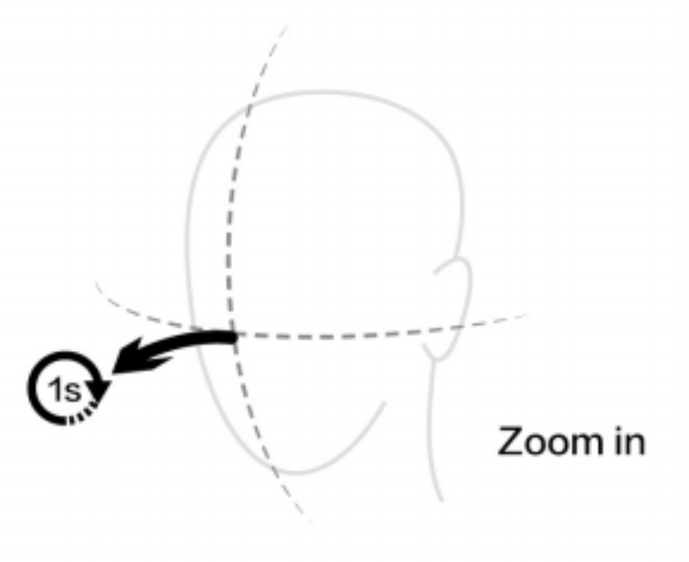
Head Rotation or Gaze? Maybe A Study
MOTIVATION
Gaze characteristics in HMD haven’t been explored
Which plays a more important role in VR interactions? Head rotation or gaze?
Integrate gaze as a feature into VR tasks
Navigation
Manipulation
Object rearrangement
PILOT STUDY
To be continued...

Slide 5
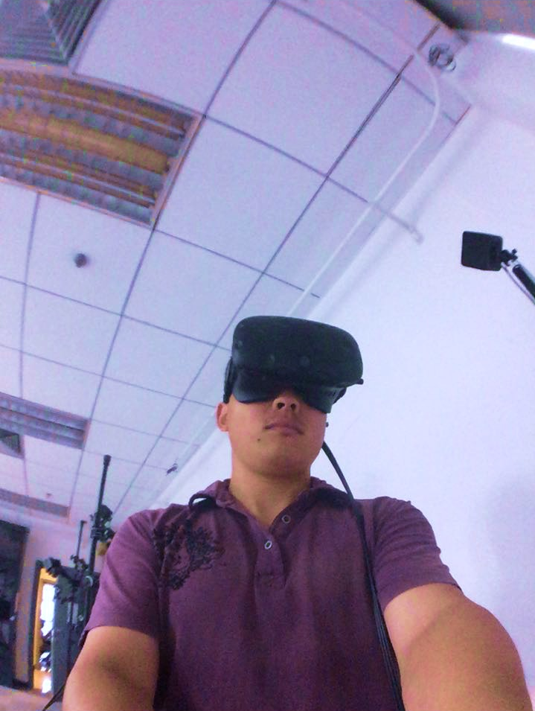
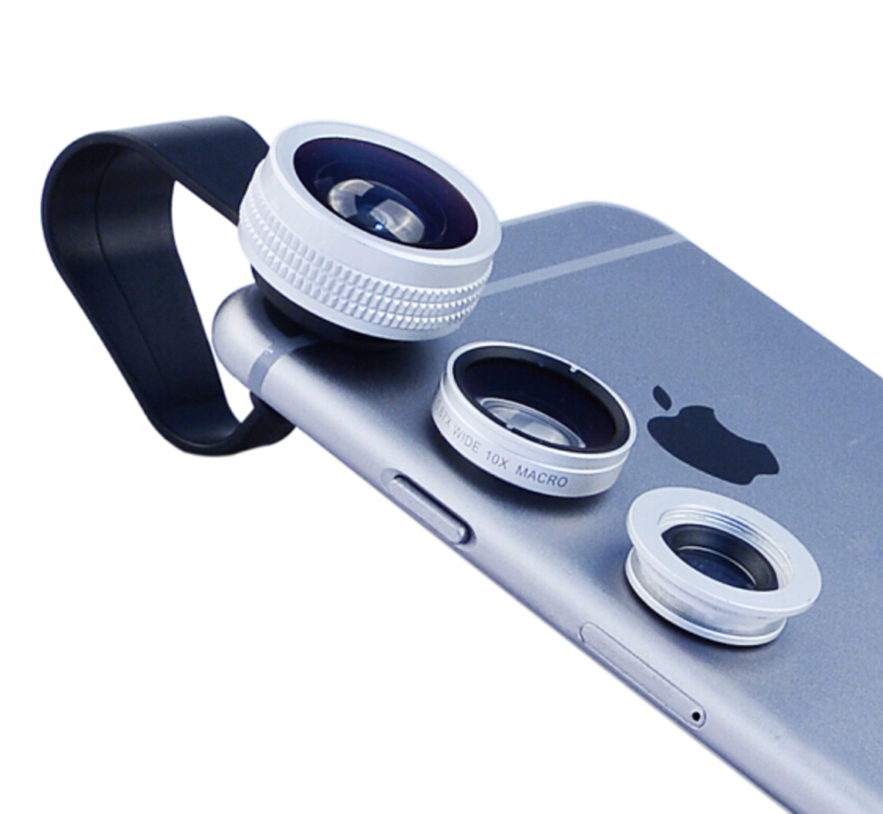
Smartphone as A Tracked VR Controller
MOTIVATION
Lack of controllers for many HMDs
Smartphone is used on a daily basis
Low-cost tracking and environmental robustness
METHOD
Tracking the position relative to HMD with front-facing camera and fisheye lens
Computer vision and machine learning
IMU refine the tracking result

